Slide 1
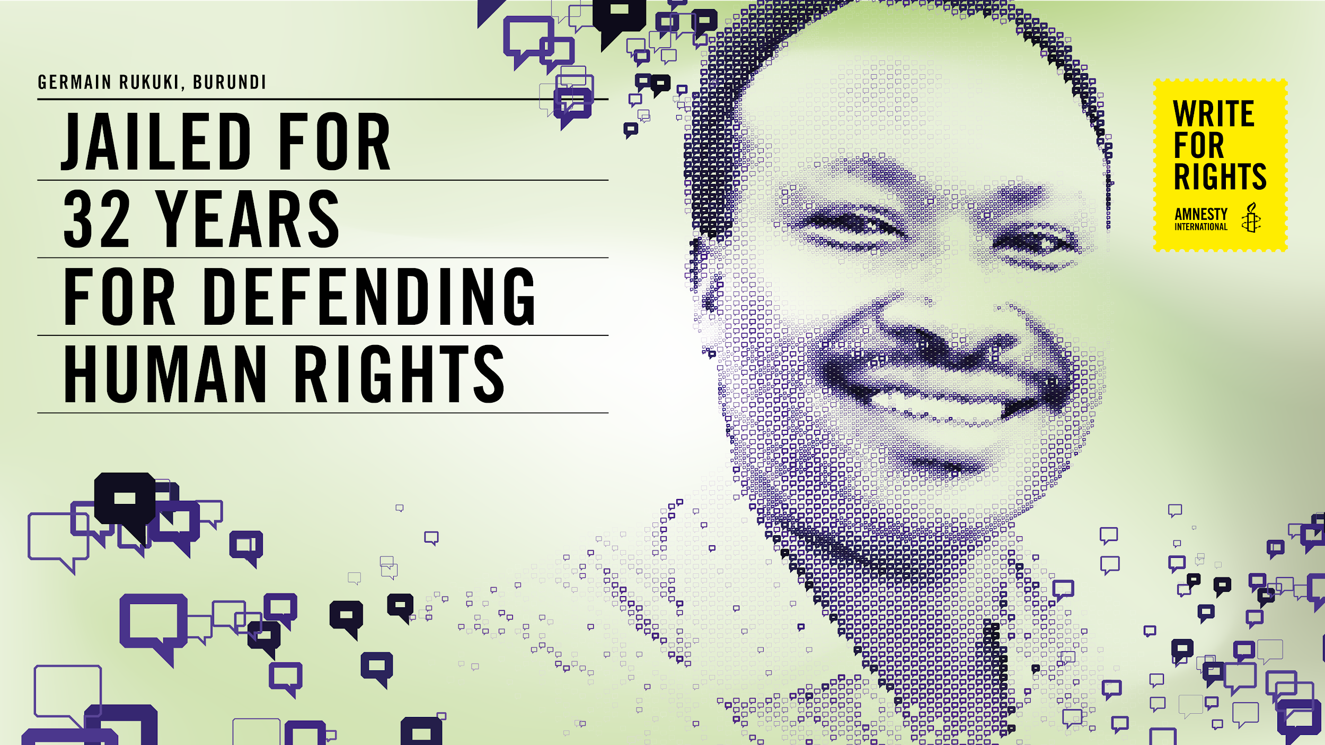
Notes:
The powerpoint presentation needs be used together with the HRE activity of the same name that you can download here https://www.amnesty.org/en/latest/education/2020/10/write-for-rights-human-rights-education-toolkits/

Slide 2
STANDING UP TO INJUSTICE
Focus on one time in your life where you spoke up about something that was unjust.
What happened?
Why did you speak up?
Were there any consequences for you, positive or negative?
How did it affect you in terms of your willingness to speak up
about something again?
Take a couple of minutes to write down the answers or draw something that illustrates your reflection on the questions above.
W4R 2020 ACTIVITY: DEFENDING HUMAN RIGHTS
2
Notes:
Ask participants to get a paper and something to write or draw during self-reflection. Read the following paragraph aloud and ask participants to use the time to reflect individually: Focus on one time in your life where you spoke up about something that was unjust. What happened? Why did you speak up? Were there any consequences for you, positive or negative? How did it affect you in terms of your willingness to speak up about something again? Give participants a couple of minutes to write, draw or create as they reflect on the questions.

Slide 3
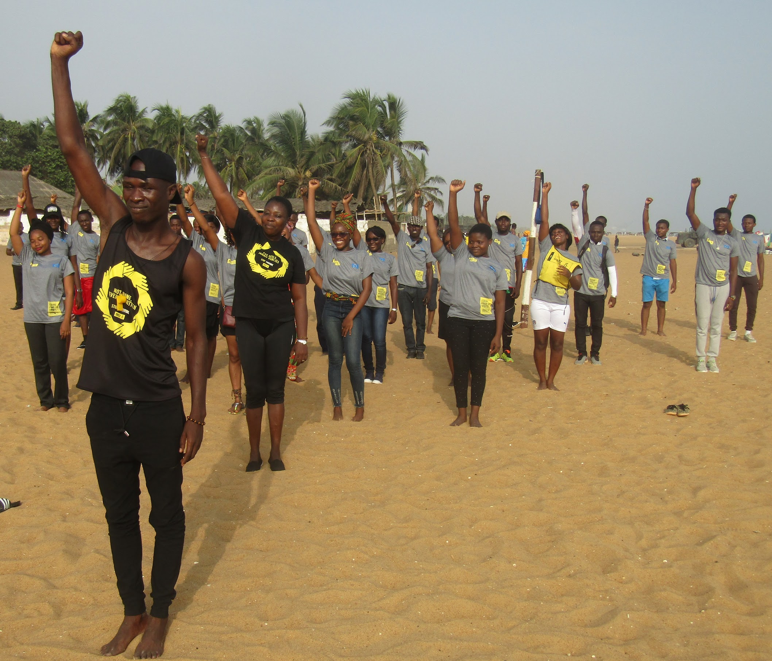
STANDING UP TO INJUSTICE
Sharing our experiences
W4R 2020 ACTIVITY: DEFENDING HUMAN RIGHTS
3

Slide 4
STANDING UP
TO INJUSTICE
Reflection:
What did you learn from this exercise?
Is it hard for you to stand up against injustice – why or why not?
What would you need in order to speak out against injustice more often?
W4R 2020 ACTIVITY: DEFENDING HUMAN RIGHTS
4
Notes:
Ask participants to reflect on these questions.

Slide 5
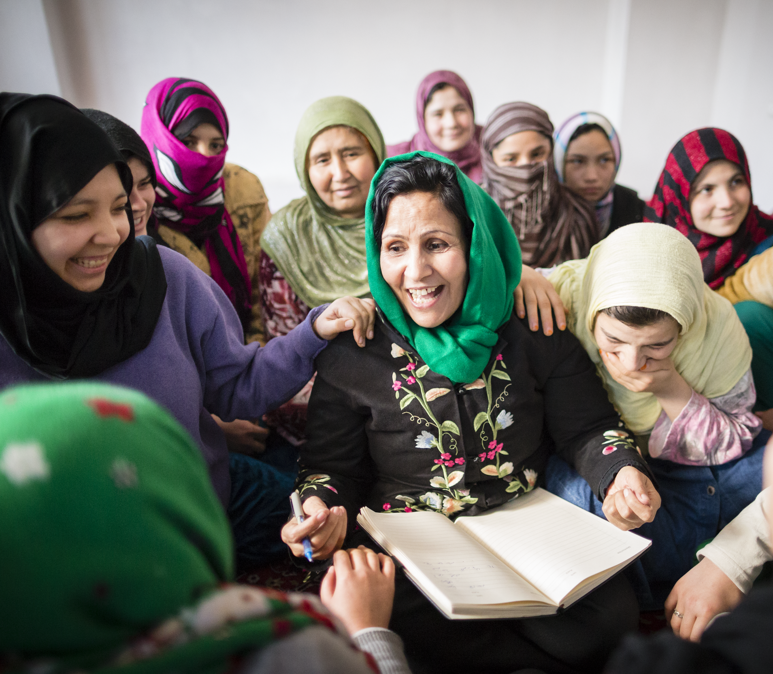
HUMAN RIGHTS
DEFENDER
“Human rights defender” is a term used to describe people who, individually or with others, act to promote or protect human rights without advocating or using violence”
W4R 2020 ACTIVITY: DEFENDING HUMAN RIGHTS
5
Notes:
Explain to participants that they will be learning about a person in Burundi who is in jail for defending human rights. Germain is a human rights defender and has been detained because of this.

Slide 6
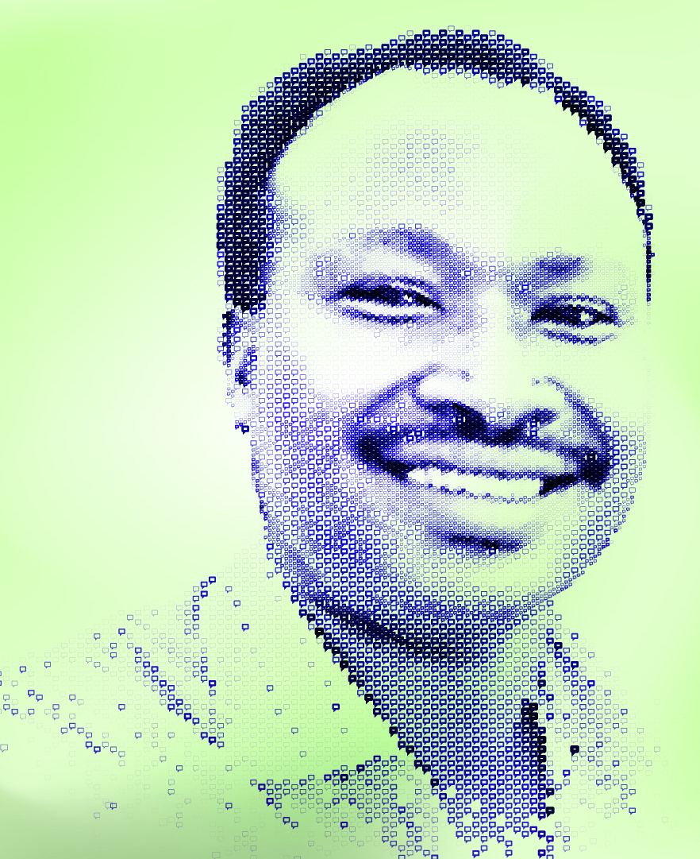
GERMAIN’S STORY
In better times, Germain Rukuki liked nothing more than playing with his sons, now aged seven and six. He also loved music, Bob Marley’s “Redemption Song” being a favourite – an apt choice, as it would later turn out.
It was early one morning in July 2017 when Germain and his wife, Emelyne Mupfasoni, were woken by heavy footfall and banging on their door. Dozens of members of the security forces had piled into their compound. Emelyne was just weeks away from giving birth to their third child.
Officers interrogated the couple, both NGO workers, in their home. They arrested Germain, later transferring him to Ngozi prison, northern Burundi, where he remains to this day.
On 26 April 2018, Germain was found guilty of a slew of sham charges, including “rebellion” and “threatening State security”. His previous association with the NGO Action by Christians for Abolition of Torture (ACAT-Burundi) was used against him. ACAT-Burundi had been shut down in 2016 for allegedly “tarnishing the image of the country”. But one of the prosecution’s pieces of “evidence” during the trial included an email Germain had written to them when they were still legal.
Germain was sentenced to 32 years in prison. He and his three-year-old son have never laid eyes on each other.
“How long must my husband suffer this injustice?” asks Emelyne.
W4R 2020 ACTIVITY: DEFENDING HUMAN RIGHTS
6
Notes:
Ask participants to read Germain’s story. Ask participants to How do they feel after reading the story ?
Optional you can send Link to word cloud (https://www.mentimeter.com/) in the chat

Slide 7
GERMAIN’S
STORY
QUESTIONS TO DISCUSS
Are there any similarities or differences between experiences in your life and those of Germain’s? What are they?
What messages are Burundi authorities sending to other human rights defenders in the country by their treatment of Germain?
What impact might it have if someone is made a scapegoat, or used to set an example, on other people who defend human rights?
W4R 2020 ACTIVITY: DEFENDING HUMAN RIGHTS
7
Notes:
Reflect with the participants on the following questions.

Slide 8
WHICH HUMAN RIGHTS
ARE VIOLATED
Freedom and equality in dignity and rights
Non-discrimination
Right to life, liberty and security of person
Freedom from slavery
Freedom from torture
All are protected by the law
All are equal before the law
A remedy when rights have been violated
No unjust detention, imprisonment or exile
Right to a fair trial
Innocent until proven guilty
Privacy and the right to home and family life
Freedom to live
Right to travel freely within state borders and to other countries
Right to a nationality
W4R 2020 ACTIVITY: DEFENDING HUMAN RIGHTS
8
Notes:
Explain to participants that you will read through the articles in the UDHR summary on the slide. Each time someone feels that Germain or his family’s human rights have been violated, they should raise their hand and/or put the number of the corresponding right in the chat. As participants are still learning about human rights and only have limited information about Germain’s story, they may come to different conclusions about the rights involved, but this is ok. Read through the articles, one by one, and give participants time to raise their hand and/or write the number in the chat. Ask a few to explain why they have chosen that right.

Slide 9
WHICH HUMAN RIGHTS
ARE VIOLATED
Right to marry and start a family
Right to own property and possessions
Freedom of belief (including religious belief)
Freedom of expression and the right to spread information
Freedom to join associations and meet with others in a peaceful way
Right to take part in the government of your country
Right to social security
Right to work for a fair wage and join a trade union
Right to rest and leisure
Right to an adequate standard of living
Right to education
Right to share in your community’s cultural life
Right to an international order where all these rights can be fully realized
Responsibility to respect the rights of others
No taking away any of these rights!
W4R 2020 ACTIVITY: DEFENDING HUMAN RIGHTS
9
Notes:
Explain to participants that you will read through the articles in the UDHR summary on the slide. Each time someone feels that Germain or his family’s human rights have been violated, they should raise their hand and/or put the number of the corresponding right in the chat. As participants are still learning about human rights and only have limited information about Germain’s story, they may come to different conclusions about the rights involved, but this is ok. Read through the articles, one by one, and give participants time to raise their hand and/or write the number in the chat. Ask a few to explain why they have chosen that right.

Slide 10
HUMAN RIGHTS VIOLATIONS IN
THE CASE OF GERMAIN RUKUKI
Name of human right | Relevance to Germain’s case
Right to a fair trial | Germain was detained without charge and interrogated without access to a lawyer. He was sentenced to 32 years in prison and was not in court when his verdict was delivered. An appeal also resulted in the same, with neither his lawyers or himself present when the verdict was announced.
Right to security of person | Germain was detained for several days without being charged.
Right to liberty | Germain has been detained and has remained behind bars since July 2017 for his human rights work in an NGO.
Right to be free from ill treatment | Germain is detained in a hugely overcrowded prison where there are suspected Covid 19 deaths and no measures for decongestion have been made.
Right to freedom of expression | Germain has been detained and has remained behind bars since July 2017 for his human rights work in an NGO speaking out against torture.
Right to be presumed innocent until and unless proven guilty in a fair trial | One of the key pieces of evidence used to charge and sentence Germain was an email exchange between him and his place of work, then a legally registered NGO.
Right to private life | Germain has not been able to see his family or meet his youngest son since he was detained in 2017.
Right to be free from discrimination | Germain has been targeted as a human rights defender and used an example to warn off others who are active in defending human rights.
W4R 2020 ACTIVITY: DEFENDING HUMAN RIGHTS
10
Notes:
Share and read the relevant rights that are affected in Germain’s case

Slide 11
RELEVANT HUMAN
RIGHTS
Are you surprised at the number of human rights violations Germain has been subject to?
Do you think the charges against Germain are justified?
W4R 2020 ACTIVITY: DEFENDING HUMAN RIGHTS
11

Slide 12
HOW CAN CHANGE
HAPPEN
What needs to happen in order to bring justice, truth and reparation for Germain and other human rights defenders?
W4R 2020 ACTIVITY: DEFENDING HUMAN RIGHTS
12
Notes:
Brainstorm with participants

Slide 13

HOW DOES WRITE
FOR RIGHTS WORK?
WHY DO WE NEED
TO TAKE ACTION?
In country after country, people’s freedom
to speak out against injustice, to live on their ancestral lands, to not be discriminated against –
is under threat.
Our letters, words and actions will put pressure on authorities to take immediate ​ action, so that those who abuse will be brought to justice. And those unjustly imprisoned will taste freedom ​once again.
People in more than 170 countries and territories take part in all kinds of events
Writing millions of letters, emails, tweets and petitions
Supporting people who’ve been harassed, threatened and unjustly jailed
Putting pressure on governments, leaders and decision-makers
Showing love and support for the people and their families
And making change happen – releasing activists, securing justice for those whose rights have been wronged and protecting people who stand up for change
W4R 2020 ACTIVITY: DEFENDING HUMAN RIGHTS
13
Notes:
Explain to participants about the Write to Right Campaign that Amnesty runs each year using the slide.

Slide 14
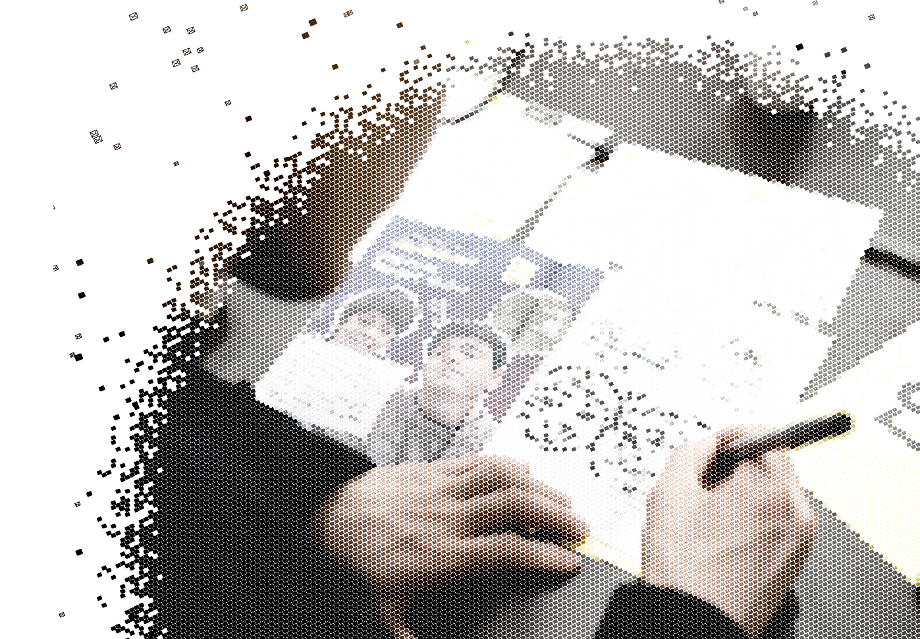
HOW TO WRITE
FOR RIGHTS
1. LISTEN TO THE STORIES
2. WRITE YOUR LETTERS TO:
The government we are trying to persuade to help
the person or people featured in each case
The person or people we want to help, or someone they are close to
3. TAG YOUR LETTERS SO AMNESTY
CAN FIND ​THEM ON SOCIAL
Take a photo of your letter
Post in on your social media channels, tagging it with the unique
event hashtag
Make sure the posts are public so we can find it
4. AMNESTY WILL DELIVER YOUR LETTERS
Amnesty will then collect all actions and give them to the
governments, the people we’re trying to help, or their families
W4R 2020 ACTIVITY: DEFENDING HUMAN RIGHTS
14
Notes:
Explain how to write for rights using the slide. Explain that Amnesty is encouraging people to write letters to the authorities and show solidarity for Germain

Slide 15
WRITE A LETTER,
CHANGE A LIFE
Encourage the participants to write to the President of Burundi at the following address:
Evariste Ndayishimiye, President of the Republic
Ntare Rushatsi House
Bujumbura, Burundi.
Email: presidence@burundi.gov.bi
@GeneralNeva – Twitter, Facebook and Instagram
Salutation: Dear Mr President
You can use the template letters in the letter writing toolkit which you can download on the Write for Rights web page at www.amnesty.org/writeforrights
Use the following guidelines to
write a more personal letter:
Tell the President something to make this a personal letter:
Tell him something about yourself
Tell him what shocks you about the case
Ask him to release Germain immediately and unconditionally.
Remind him that in his inaugural speech as President he made a commitment to respect human rights.
W4R 2020 ACTIVITY: DEFENDING HUMAN RIGHTS
15
Notes:
Explain that Amnesty is encouraging people to write letters to authorities and show solidarity for Germain
If there isn’t enough time for participants to take action by writing letters.
Participants can also take action online. Share the link https://www.amnesty.org/en/get-involved/write-for-rights/ in the chat.
Tip: You could play some music for the group while they complete this activity

Slide 16
SHOW
SOLIDARITY
Show solidarity with Germain and his wife Emelyne Mupfasoni directly.
Write letters and post online messages expressing your support or any encouraging words to Germain and/or his wife Emelyne.
Germain was sentenced to 32 years in prison for doing his human rights work in Burundi. Your words will give comfort to Germain Rukuki for the injustices he has faced since his arrest in July 2017.
Send your messages of support to Germain or his wife Emelyne including the Kirundi words:
Komera Turikumwe!
It means: Stay strong, we are together!
Take pictures of your actions, post them on Twitter, Facebook, Instagram using the hashtags #FreeGermainRukuki, #FreeDefenders for your action
to be captured on social media
Messages for Germain or Emelyne can be sent to the Amnesty International office:
Amnesty International Regional Office for East Africa,
the Horn and Great Lakes, c/o Burundi Team
Riverside Studios, Riverside Lane,
Off Riverside Drive
P.O Box 1527-00606
Nairobi – Kenya
Email: burunditeam@amnesty.org
W4R 2020 ACTIVITY: DEFENDING HUMAN RIGHTS
16
Notes:
You could play nice music and have people holding their messages or letters and you can take a screenshot of the screen and a joint solidarity photo. Share on social media with #W4R20 You can also ask people to go online and sign the petition. You can share the link in the chat https://www.amnesty.org/en/get-involved/write-for-rights/

